Slide 1
Paint UML

Slide 2
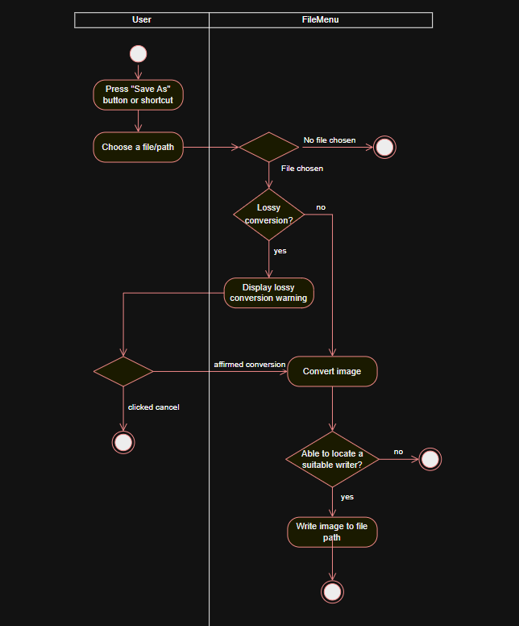
“Save As” Activity Diagram

Slide 3
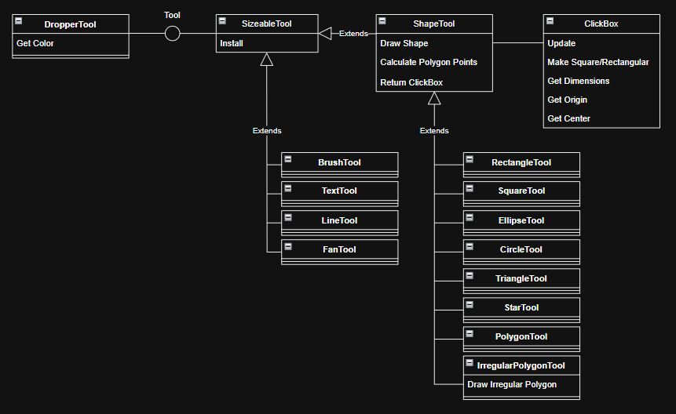
Tool Class Diagram

Slide 4
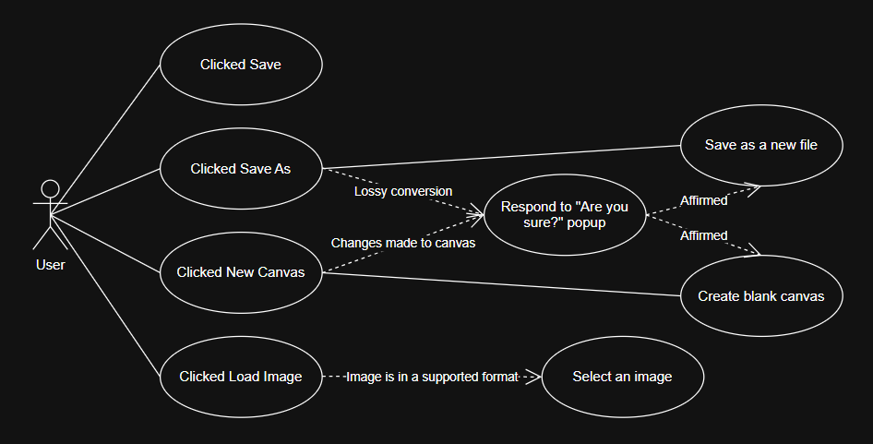
File Menu Use Case Diagram

Slide 5
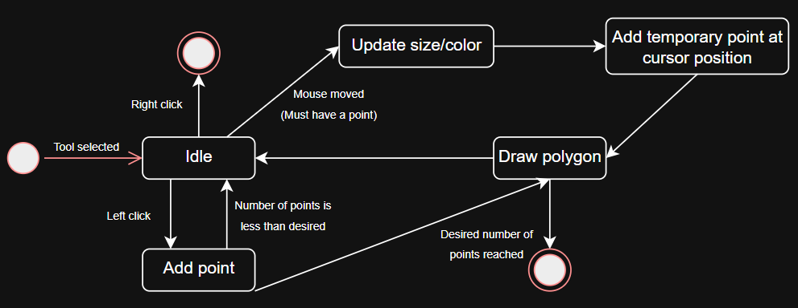
Irregular Polygon Tool State Diagram

